Slide 1



Number Systems
Module 1- Data Representation
1.1

Slide 2
LECTURE PREVIEW
Recap of previous lecture
Counting in Decimal and Binary
Place Value
Binary to Decimal Conversion
Decimal to Binary Conversion
Electronic Translators
Hexadecimal Numbers
Octal Numbers

Slide 3
BASIC LOGIC BLOCK - GATE -
Logic Gates
Binary
Digital
Input
Signal
Binary
Digital
Output
Signal
.
.
Gate
.
Types of Basic Logic Blocks
- Combinational Logic Block
Logic Blocks whose output logic value
depends only on the input logic values
- Sequential Logic Block
Logic Blocks whose output logic value
depends on the input values and the
state (stored information) of the blocks
Functions of Gates can be described by
- Truth Table
- Boolean Function
- Karnaugh Map

Slide 4
BOOLEAN ALGEBRA
Boolean Algebra
Boolean Algebra
* Algebra with Binary(Boolean) Variable and Logic Operations
* Boolean Algebra is useful in Analysis and Synthesis of
Digital Logic Circuits
- Input and Output signals can be
represented by Boolean Variables, and
- Function of the Digital Logic Circuits can be represented by
Logic Operations, i.e., Boolean Function(s)
- From a Boolean function, a logic diagram
can be constructed using AND, OR, and I
Truth Table
* The most elementary specification of the function of a Digital Logic
Circuit is the Truth Table
- Table that describes the Output Values for all the combinations
of the Input Values, called MINTERMS
- n input variables → 2^{n} minterms

Slide 5
LOGIC CIRCUIT DESIGN
Boolean Algebra
x y z F
0 0 0 0
0 0 1 1
0 1 0 0
0 1 1 0
1 0 0 1
1 0 1 1
1 1 0 1
1 1 1 1
Truth
Table
Boolean
Function
F = x + y’z
x
F
Logic
Diagram
y
z

Slide 6
BASIC IDENTITIES OF BOOLEAN ALGEBRA
Boolean Algebra
[1] x + 0 = x
[3] x + 1 = 1
[5] x + x = x
[7] x + x’ = 1
[9] x + y = y + x
[11] x + (y + z) = (x + y) + z
[13] x(y + z) = xy +xz
[15] (x + y)’ = x’y’
[17] (x’)’ = x
[2] x • 0 = 0
[4] x • 1 = x
[6] x • x = x
[8] x • X’ = 0
[10] xy = yx
[12] x(yz) = (xy)z
[14] x + yz = (x + y)(x + z)
[16] (xy)’ = x’ + y’
[15] and [16] : De Morgan’s Theorem
Usefulness of this Table
- Simplification of the Boolean function
- Derivation of equivalent Boolean functions
to obtain logic diagrams utilizing different logic gates
-- Ordinarily ANDs, ORs, and Inverters
-- But a certain different form of Boolean function may be convenient
to obtain circuits with NANDs or NORs
→ Applications of De Morgans Theorem
x’y’ = (x + y)’ x’+ y’= (xy)’
I, AND → NOR I, OR → NAND

Slide 7
EQUIVALENT CIRCUITS
Boolean Algebra
Many different logic diagrams are possible for a given Function
F = ABC + ABC’ + A’C .......…… (1)
= AB(C + C’) + A’C [13] ..…. (2)
= AB • 1 + A’C [7]
= AB + A’C [4] ...…. (3)
(1)
(2)
(3)
A
B
C
F
A
B
C
F
A
B
C
F

Slide 8
SIMPLIFICATION
Map Simplification
Truth
Table
Boolean
Function
Unique
Many different expressions exist
Simplification from Boolean function
- Finding an equivalent expression that is least expensive to implement
- For a simple function, it is possible to obtain
a simple expression for low cost implementation
- But, with complex functions, it is a very difficult task
Karnaugh Map (K-map) is a simple procedure for
simplifying Boolean expressions.
Truth
Table
Simplified
Boolean
Function
Karnaugh
Map
Boolean
function

Slide 9
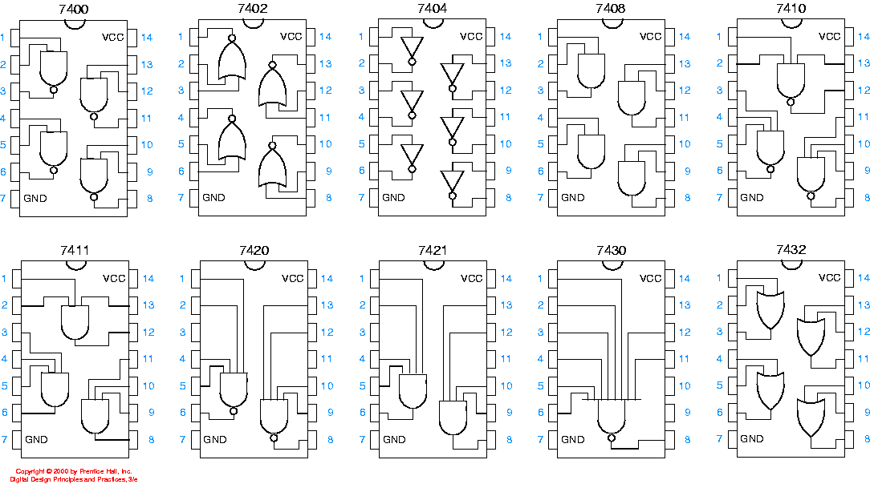
Gates in ICs
END OF REVIEW

Slide 10
Number Systems: Objectives of this lecture
After studying this module, students should be able to:
Understand and use various number systems
Convert numbers between different number systems
Perform arithmetic on data in various number systems
Understand and use data encoding systems
1.2

Slide 11
introduction
ALL data stored and processed by digital computers are in binary code. 1s & 0s
The 1s & 0s are represented by voltages in the computer
eg +5 volts = binary 1 and 0 volts = binary 0
Many different binary coding systems exist in order to cope with different number and data types
Examples are:
  unsigned integers 5, 77, 92
  signed integers -34, -123
  reals 3.338, -1234.6543
  characters a,b,c,
  strings Once upon a time there was only machine code
1.3

Slide 12
Binary numbers
00000001 = 1
00000010 = 2
00000011 = 3
00000100 = 4
00000101 = 5
00000110 = 6
00000111 = 7
00001000 = 8
00001001 = 9
00001010 = 10
Binary numbers are widely used in applications that deal with a choice of one or two conditions, example, on-off or high-low.
Binary numbers use only two digits 0 and 1 for different place counts
The train of pulses is a digital signal containing information about the sequence of HIGH and LOW levels.
The binary numbers are usually written in groups of four or eight. Each 0 of 1 is called a bit. A group of four bits is a nibble. Eight bits make a byte.

Slide 13

Counting with binary numbers
Decimal system
Binary system

Slide 14
Number Systems
We use number systems based on positional number systems where the position of a digit within the number determines the digits value
For the decimal number system the positional values are: 10⁴ 10³ 10² 10¹ 10⁰
Example
23₁₀ = 2 x 10¹ + 3 x 10⁰
= 2 x 10 + 3 x 1 = 20 + 3 = 23
1.4
Notes:
There is more text on this slide but I don’t know how to do it.

Slide 15
However, with the binary system the weights increase from right to left in powers of two for each bit, as shown in the figure below:
Binary weight
Weight value
2⁷ 2⁶ 2⁵ 2⁴ 2³ 2² 2¹ 2⁰
128 64 32 16 8 4 2 1
H G F E D C B A
Binary point
The right-most bit is the least significant bit, (LSB) and the left-most bit is the most significant bit (MSB). Only eight places are illustrated, but more places can be used for bigger numbers

Slide 16
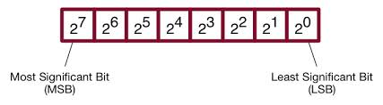

Slide 17
Example
Example: convert the binary number (1101)₂ to decimal form.
Solution:
Binary weight: 2³ 2² 2¹ 2⁰
Weight value: 8 4 2 1
Binary Number: 1 1 0 1
= 1 x 8 + 1 x 4 + 0 +1 x 1 = (13)₁₀
Highest decimal number = 2^{n} -1

Slide 18
BINARY TO DECIMAL CONVERSION
Convert Binary Number 110011 to a Decimal Number:
Binary
1 1 0 0 1 1
Decimal
32 + 16 + 0 + 0 + 2 + 1 = 51

Slide 19

TEST
Convert the following binary numbers into decimal numbers:
Binary 1001 =
9
Binary 1111 =
15
Binary 0010 =
2

Slide 20
Representation of fractional numbers
Fractional numbers can also be represented in binary form by placing bits to the right of the decimal point. The weights of the digit in a binary number are:
2^{n-1} ……2³ 2² 2¹ 2⁰ . 2⁻¹, 2⁻²,…..2^{-n}
Binary point

Slide 21
Decimal–to-Binary Conversion
Repeated Division-by-2 Method
Repeated Multiplication-by-2 method
  Converting decimal fractions to binary

Slide 22
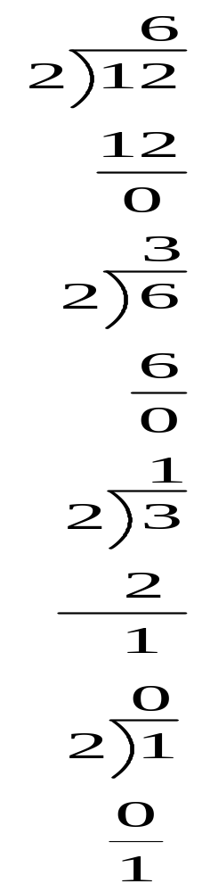
Remainder
?? EXAMPLE:
Convert the decimal number 12 to binary
Step 1
0
LSB
Step 2
0
We divide each quotient by 2 until there is a 0 quotient
Step 3
1
Indication to stop
Step 4
1
MSB
1100

Slide 23
DECIMAL TO BINARY CONVERSION
Divide by 2 Process
Decimal #
13 ÷ 2 = 6 remainder 1
6 ÷ 2 = 3 remainder 0
3 ÷ 2 = 1 remainder 1
1 ÷ 2 = 0 remainder 1
1
1
0
1

Slide 24
TEST
Convert the following decimal numbers into binary:
Decimal 11 =
1011
Decimal 4 =
0100
Decimal 17 =
10001

Slide 25
Converting decimal fractions to binary
Carry Fractional part
Step 1 0.3125 x 2 = 0.625 Carry
0 MSB
Step 2 0.625 x 2 = 1.25
1
Step 3 0.25 x 2 = 0.50
0
Step 4 0.50 x 2 = 1.00
1 LSB
0.0101

Slide 26
ELECTRONIC TRANSLATORS
Devices that convert from decimal to binary numbers and from binary to decimal numbers.
Encoders -
translates from decimal to binary
Decoders -
translates from binary to decimal

Slide 27
ELECTRONIC ENCODER - DECIMAL TO BINARY
Binary output
Decimal input
0 0 0 0
0 1 0 1
0 1 1 1
0 0 1 1
7
Decimal
to
Binary
Encoder
5
3
0
Encoders are available in IC form.
This encoder translates from decimal input to binary (BCD) output.

Slide 28
ELECTRONIC DECODING: BINARY TO DECIMAL
Binary input
Decimal output
0 0 0 0
0 0 0 1
0 0 1 0
0 0 1 1
0 1 0 0
Binary-to-
7-Segment
Decoder/
Driver
Electronic decoders are available in IC form.
This decoder translates from binary to decimal.
Decimals are shown on an 7-segment LED display.
This decoder also drives the 7-segment display.

Slide 29
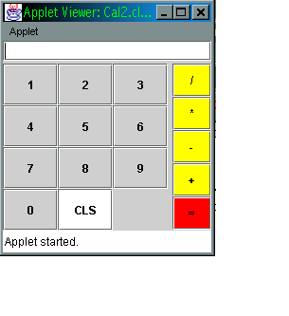
Electronic translators
Keyboard input
Processing unit
Encoder
Output
Decoder
Decimal
Binary
decimal
9
1001
9
The diagram above illustrates a typical system that may be used to translate from decimal s to binary and back to decimals.

Slide 30
Binary Arithmetic
Binary arithmetic is fundamental to all digital computers and many other types of digital systems. To understand digital systems, one must know the basics of binary
  Addition
  Subtraction
  Multiplication
  division

Slide 31
Example
Add 1001 and 0110.
(1001)₂ (9)₁₀
+(0110)₂ +(6)₁₀
(1111)₂ (15)₁₀

Slide 32
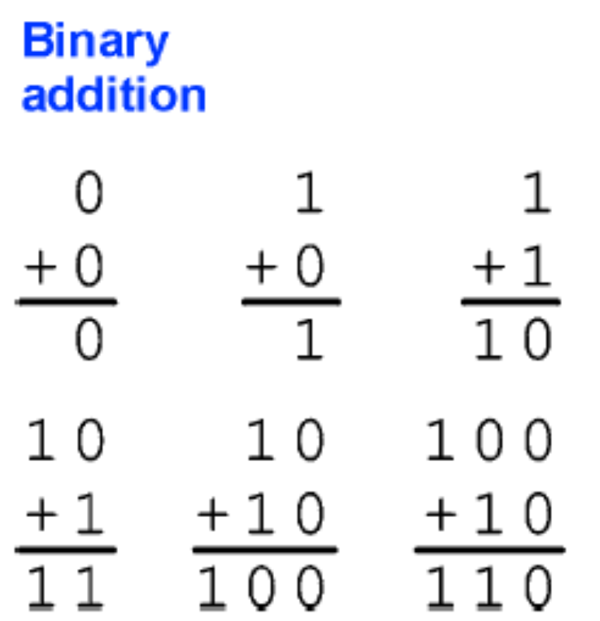
Example2

Slide 33
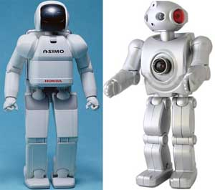
Adders
Half Adder
Full Adder

Slide 34
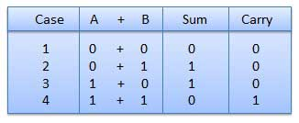
Binary addition
There are four basic rules for adding binary digits

Slide 35
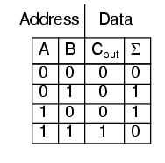
Half Adder
2 inputs
2 outputs
C_{in} C_{in}
A₁ A₀
+
B₁ B₀
Σ₁ Σ₀
+ +
C_{out} C_{out}

Slide 36
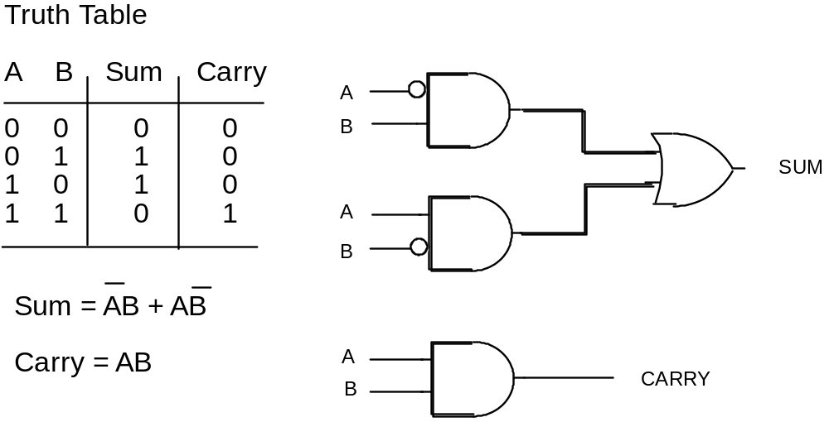
Half Adder
Truth Table
2.27

Slide 37
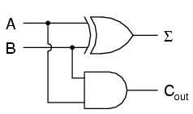
Half adder circuit for addition in the LSB column
A B
HA
C_{o} Σ
= A₀B₀ + A₀B₀
= A₀B₀

Slide 38
Full Adder
A₁ | B₁ | C_{in} | Σ₁ | C_{out}
0 | 0 | 0 | 0 | 0
0 | 0 | 1 | 1 | 0
0 | 1 | 0 | 1 | 0
0 | 1 | 1 | 0 | 1
1 | 0 | 0 | 1 | 0
1 | 0 | 1 | 0 | 1
1 | 1 | 0 | 0 | 1
1 | 1 | 1 | 1 | 1
C_{in} C_{in}
A₁ A₀
+
B₁ B₀
Σ₁ Σ₀
+ +
C_{out} C_{out}

Slide 39
Binary Arithmetic
Adders
A₁
Σ₁ = 1 for odd number of high inputs
B₁
C_{IN}
A₁
B₁
A₁
C_{IN}
C_{out} = 1 for any two inputs
B₁
C_{IN}
Julio D. Dondo Gazzano FPGA & VHDL WORKSHOP KUMASI GHANA- 2005

Slide 40
A B
Logic Circuit of A Full Adder
FA
C_{o} Σ
A₁
B₁
Σ
C_{IN}
C_{out}
Julio D. Dondo Gazzano FPGA & VHDL WORKSHOP KUMASI GHANA- 2005

Slide 41
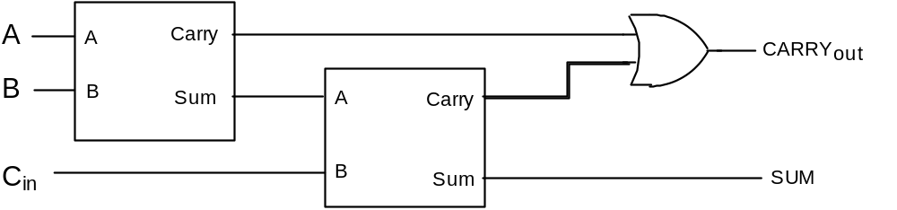
Full Adder
A Full Adder is able to ADD in the carry from the previous column in a multi-digit binary number. The design could be carried out via a Truth Table, but a simpler method is to use two Half Adders.
2.28

Slide 42
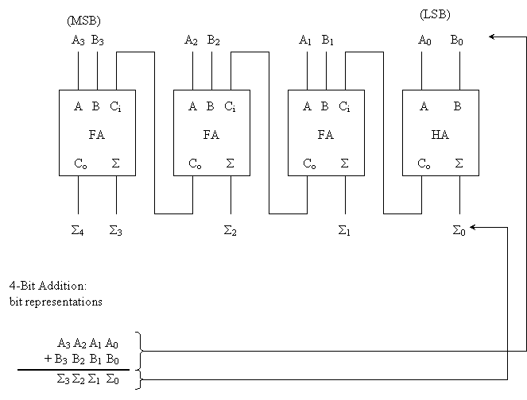
4 –Bit Adder

Slide 43
Reading assignments
Chapter 6 pages 234 – 244
Chapter 7 pages 271 - 274

Slide 44
Subtraction
There are four basic rules for subtracting binary digits:
0 – 0 = 0
1 – 1 = 0
1 – 0 = 1
10 – 1 = 1 (0 – 1 with a borrow of 1)

Slide 45
Example
101
011
010

Slide 46
Subtraction by adding the complement
Obtaining the 1’s Complement of a binary number
The 1’s complement of a binary number is found by simply changing 1s to 0s and all 0s to 1s.
Binary Number 1’s Complement
10101 01010
10111 01000
111100 000011
11011011 00100100

Slide 47

Example
Subtract 0011 from 1001 (i.e subtract 3 from 9)
1001 (original minuend)
+1100 (complement)
0101
1 (carry around)
0110 (answer)

Slide 48
Example
Subtract 1001 from 0011 (i.e subtract 9 from 3)
0011 (original minuend)
+0110 (complement)
1001 (sum)
- 0110 (answer)

Slide 49
Rules for 1’s complement subtraction
Convert the subtrahend to its complement by changing 0 to 1 and 1 to 0 for all digits
Add the complement to the minuend, which is the number from which the subtrahend is to be subtracted.
If there is a carry- out of 1 from the most significant place at the left, move this carry around to the least significant place at the right and add the 1 in this column.

Slide 50
Rules for 1’s complement subtraction cntd.
If there is no carry-out for this last column, the answer for the subtraction is negative, meaning that the subtrahend is larger than the minuend. In this case, take the complement of all the digits in the sum and give this answer a negative sign.

Slide 51
Subtraction by adding the complement
Obtaining the 2’s Complement of a binary number
The 2’s complement of a binary number is found by adding 1 to the 1’s complement of a number
Binary Number
2’s complement
110
001 1’s complement
+1 Adding 1
010 2’s complement

Slide 52

2’s Complement subtraction
For subtracting a smaller number from a larger one, the 2’s complement method is applied as follows;
  Determine the 2’s complement of the smaller number
  Add the 2’s complement to the larger number.
  Discard the final carry (there is always a carry in this case)

Slide 53
Example, subtract 1011 from 1100, using the 2’s method
1100
+0101 2’s complement of 1011
1 0001 discard carry
0001 final answer

Slide 54
2’s Complement subtraction
For subtracting a larger number from a smaller one
  Determine the 2’s complement of the larger number
  Add the 2’s complement to the smaller number
  There is no carry from the left-most column, the result is in 2’s complement form and is negative.
  To get the final answer, take the 2’s complement of the result, and change the sign

Slide 55
Example, subtract 11100 from 10011, using the 2’s method
10011
+00100 2’s complement of 11100
10111 no carry; 2’s complement of answer
-01001 final answer

Slide 56
Binary representation of signed numbers
The capability of handling both positive and negative numbers is a requirement of any digital system that does arithmetic operation.
A signed number consists of sign and magnitude information.
The sign indicates whether a number is positive or negative and the magnitude is the value of the number.

Slide 57
The sign is represented by including an additional bit along with the magnitude bits. Conventionally a 0 represents a positive sign and a 1 represents a negative sign. For example, in an eight bit number the left-most bit is the sign and the remaining seven bits are magnitude bits. For decimal values of +107 and -20, the binary sign and magnitude representation are as follows;
01101011
+ sign
Magnitude (107)
- sign
10010100
Magnitude (20)

Slide 58
With an eight bit sign-and-magnitude binary number, a range of values from 01111111 = + 127 to 11111111 = -127 can be represented.
With 16 bit sign and magnitude binary number, a range from 0111111111111111 = + 32,767 to 1111111111111111 = -32,767 can be represented

Slide 59
1’s complement form of negative numbers
Negative numbers are represented in 1’s complement form by inverting all the magnitude bits and leaving the sign bits.
Example;
-53 = 10110101 11001010
true form 1’s complement form

Slide 60
2’s complement form of negative numbers
Most digital systems use 2’s complement to represent negative numbers for arithmetic operations. One method of obtaining the 2’s complement is to add 1 to the 1’s complement. Only the magnitude bit is complemented, the sign bit is left untouched. Example,
11101010 10010101 1’s complement
+ 1
10010110 2,s complement

Slide 61
2’s complement form of negative numbers
Alternatively, starting with the right-most bit, the bits remain uncomplemented up to and including the first 1. the remaining bits are inverted; the sign bit remains 1
Complemented
Uncomplemented
10110110 true form
11001010 2,s complement

Slide 62

Binary Arithmetic with signed numbers
Having understood how negative numbers are represented in complement form, we now examine how signed numbers are added, subtracted, multiplied and divided. The process introduced here are essential to the understanding of computers and microprocessor-based systems

Slide 63
Binary Addition
There are four cases that must be considered when adding two numbers.
Both numbers are positive
A positive number and a smaller negative number
A positive number and a larger negative number
Both numbers are negative
We will examine one case at a time using eight bits (a byte) to represent the sign and magnitude of each number. The 2’s complement is used to represent negative numbers

Slide 64
1. Both numbers are positive
In this case both sign bits are 0s and a 2’s complement is not required
Example: add +7 and +4
7 00000111
+4 00000100
11 00001011

Slide 65
2. A positive number and a smaller negative number
The true binary form of the positive number is added to the 2’s complement of the negative number. The sign bits are included in the addition. The final carry is discarded. The result will be positive and in true form. Example, add +15 and -6
+15 00001111
+ -6 11111010
9 1 00001001
discard carry

Slide 66
3. A positive number and a larger negative number
The true binary form of the positive number is added to the 2’s complement of the negative number. The sign bits are included in the addition. The result will be negative. Example add +16 and -24;
16 00010000
+ - 24 11101000
- 8 11111000 2’s complement of -8
NB. The result automatically comes out in two complement form because it is a negative number.

Slide 67
4. Both numbers are negative
In this case the 2’s complement of both numbers are added. The sum is a negative number in 2’s complement form. Example add -5 and -9:
-5 11111011
+-9 11110111
-14 1 11110010 2’s complement of -14
discard carry

Slide 68
Overflow
When the number of bits in the sum exceeds the number of bits in each of the numbers added, an overflow results as illustrated in the following example.
Decimal
+9
+ +8
+17
Binary
01001
+01000
10001
Sign incorrect
Magnitude incorrect
The overflow condition can occur only when both numbers are positive or both numbers are negative. It is indicated by an incorrect sign bit

Slide 69
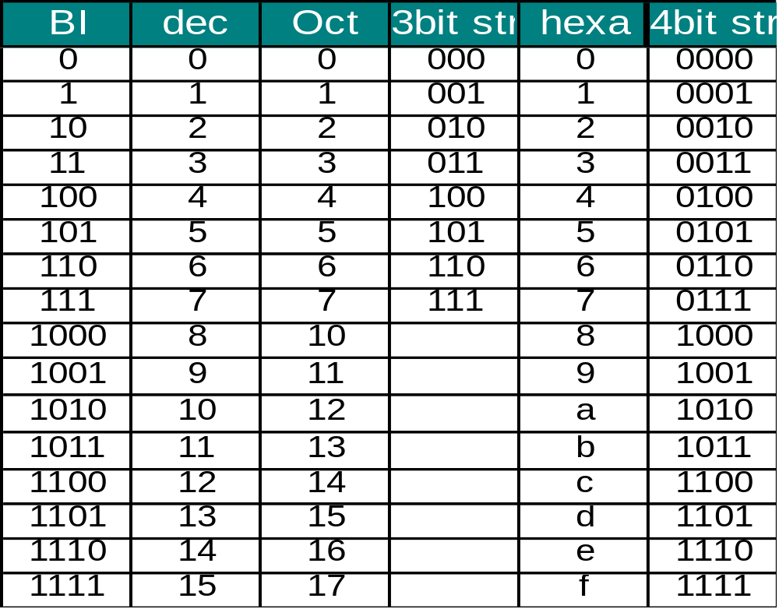
Binary Arithmetic
Binary, Octal, Decimal, and Hexadecimal numbers
Julio D. Dondo Gazzano FPGA & VHDL WORKSHOP KUMASI GHANA- 2005

Slide 70
Hexadecimal numbering system (base 16)
Hexadecimal uses 4-bit groupings; therefore, instructions or data used in 8, 16, or 32 bit computer systems can be represented as a 2, 4 or 8 digit hexadecimal code
To signify a hex number the subscript 16 or the letter H is used

Slide 71
Decimal | Binary | Hexadecimal | octal
0 1 2 3 4 5 6 7 8 9 10 11 12 13 14 15 | 0000 0001 0010 0011 0100 0101 0110 0111 1000 1001 1010 1011 1100 1101 1110 1111 | 0 1 2 3 4 5 6 7 8 9 A B C D E F | 0 1 2 3 4 5 6 7
16 17 | 10000 10001 | 10 11

Slide 72
Example
0110 1101₂
6
D
6D₁₆
To indicate a hexadecimal value we can also use prefix $ or subscript 16.
  eg $1FED or 1FED₁₆

Slide 73
HEXADECIMAL AND BINARY CONVERSIONS
Hexadecimal to Binary Conversion
Hexadecimal C 3
Binary 1100 0011
Binary to Hexadecimal Conversion
Binary 1110 1010
Hexadecimal E A

Slide 74
Conversion- Hexadecimal to Binary
Write each hexadecimal digit as a 4-bit binary number
  Example
  $FD69A
  = %1111 1101 0110 1001 1010
1.15

Slide 75
Hexadecimal
Radix=16
Symbols are: 0,1,2,3,4,5,6,7,8,9,A,B,C,D,E,F
Positional values are: 16⁴ 16³ 16² 16¹ 16⁰
Decimal values are: 65,536 4096 256 16 1
    Eg 1D7E₁₆=1 x 16³ + D x 16² + 7 x 16¹ + E x 16⁰
    =1 x 4096 + 13 x 256+7 x 16 + 14 x 1=7550₁₀
Student Exercises: Convert to decimal:
$7E=
$A8=
$13BF=
1.7

Slide 76
DECIMAL TO HEXADECIMAL CONVERSION
Divide by 16 Process
Decimal #
47 ÷ 16 = 2 remainder 15
2 ÷ 16 = 0 remainder 2
2
F

Slide 77
HEXADECIMAL TO DECIMAL CONVERSION
Convert hexadecimal number 2DB to a decimal number
Place Value
256s 16s 1s
Hexadecimal
2 D B
(256 x 2) (16 x 13) (1 x 11)
Decimal
512 + 208 + 11 = 731

Slide 78
TEST
Convert Hexadecimal number A6 to Binary
A6 =
1010 0110 (Binary)
Convert Hexadecimal number 16 to Decimal
16 =
22 (Decimal)
Convert Decimal 63 to Hexadecimal
63 =
3F (Hexadecimal)

Slide 79
Octal Numbers
Radix=8
Symbols are: 0,1,2,3,4,5,6,7.
Positional values are: 8⁴ 8³ 8² 8¹ 8⁰
Decimal values are: 4096 512 64 8 1
    eg 1573₈=1 x 8³ + 5 x 8² + 7 x 8¹ + 3 x 8⁰
    =1 x 512 + 5 x 64 + 7 x 8 + 3 x 1
    =512 + 320 + 56 + 3
    =891₁₀
1.9

Slide 80
Conversion- Hexadecimal to Binary
Student Exercises
Convert the following hexadecimal values to binary:
$FE45 =
$BBB775 =
ABCDEF₁₆ =
1.16

Slide 81
Conversion- Binary to Hexadecimal
Write each group of 4 binary bits as the equivalent Hexadecimal value.
Example
%0101 1110 1010 1011 1111 0001
= $5EABF1
NOTE: Start at the right hand end and fill the left hand end with zeros to get 4 bits.
1.17
Notes:
Not sure about the -$5EABF

Slide 82
Conversion- Binary to Hexadecimal
Student Exercises
Convert the following binary values to hexadecimal:
% 1 0000 1010 1110 1111 0010 =
0001 0001 0011 1010 1011₂ =
% 1010001110001100011000 =
1111110001010101010010₂ =
1.18

Slide 83
Alphanumeric Codes
ASCII, EBCIDIC & Unicode codes
ASCII Code- American Standard Code for Information Interchange
-7 bit code used world wide
-there are 127 different characters
-10 digits, 0-9
-26 uppercase letters
-26 lowercase letters
-7 punctuation marks
-33 control characters
-26 other characters
-usually stored in a computer in an 8-bit byte with the most significant bit left as 0.
1.53

Slide 84
ASCII CHART
MSB
LSB
000 001 010 011 100 101 110 111
0000 NUL DLE sp 0 @ P ` p
0001 SOH DC1 ! 1 A Q a q
0010 STX DC2 “ 2 B R b r
0011 ETX DC3 # 3 C S c s
0100 EOT DC4 $ 4 D T d t
0101 ENQ NAK % 5 E U e u
0110 ACK SYN & 6 F V f v
0111 BEL ETB ‘ 7 G W g w
1000 BS CAN ( 8 H X h x
1001 HT EM ) 9 I Y i y
1010 LF SUB * : J Z j z
1011 VT ESC + ; K [ k {
1100 FF FS , < L \ l
1101 CR GS - = M ] m }
1110 SO RS . > N n ~
1111 SI US / ? O o DEL
1.55

Slide 85
Codes
EBCIDC -an 8 character code invented by IBM
-256 characters
Unicode -this is a new code to cater for many of the world’s languages
-a subset corresponds to ASCII
-uses 16 bits to represent each character
1.54

Slide 86
Codes
Collating Sequence
-the order assigned within a code
-for ASCII
A 100 0001
B 100 0010
C 100 0011
D 100 0100
0 011 0000
1 011 0001
2 011 0010
Thus characters and text can be compared:
A<D
FRED<FREE
0<7
X>P
1.56

Slide 87
Codes - ASCII to binary conversion
This conversion is frequently executed by a computer to convert keyboard keys which are in ASCII to binary, when arithmetic is to be carried out.
ASCII for ‘1’= 0011 0001
To convert to binary for arithmetic, subtract %0011 000 which leaves %0000 0001.
Similarly, when printing a binary number, such as %0000 1001, (=9),the computer must add %0011 0000 to give %0011 1001 which is ASCII for ‘9’.
Converting multi-digit binary numbers, such as %1100 1110 to the ASCII characters ‘206’ is much more complex.
1.57

Slide 88
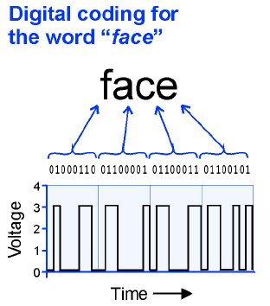

Slide 89
ASCII
Student Exercises
1. Convert the text string ‘Yoko’s in Tokyo’ to 7-bit ASCII string.
2. Convert the string ‘Mary’s eyes are blue’ to an 8-bit ASCII string.
3. Convert the 7-bit ASCII code to text:
10001111101111110111111001000100000
1101101110111111100101101110110100111011101100111010
0000100110111100100100000101001111011011101001111010
011010000101110
4. Convert the ASCII 8-bit code to text:
01001000011011110110110001101001
01100100011000010111100100101110
1.58

Slide 90
BCD Codes
BCD- Binary Coded Decimal numbers are used in systems where only numbers are being entered.
BCD arithmetic can be performed without the need to convert to binary.
BCD Table: 0= 0000 5= 0101
1= 0001 6= 0110
2= 0010 7= 0111
3= 0011 8= 1000
4= 0100 9= 1001
Codes 1010 to 1111 are not used.
Example 1,295= 0001 0010 1001 0101
1.71

Slide 91
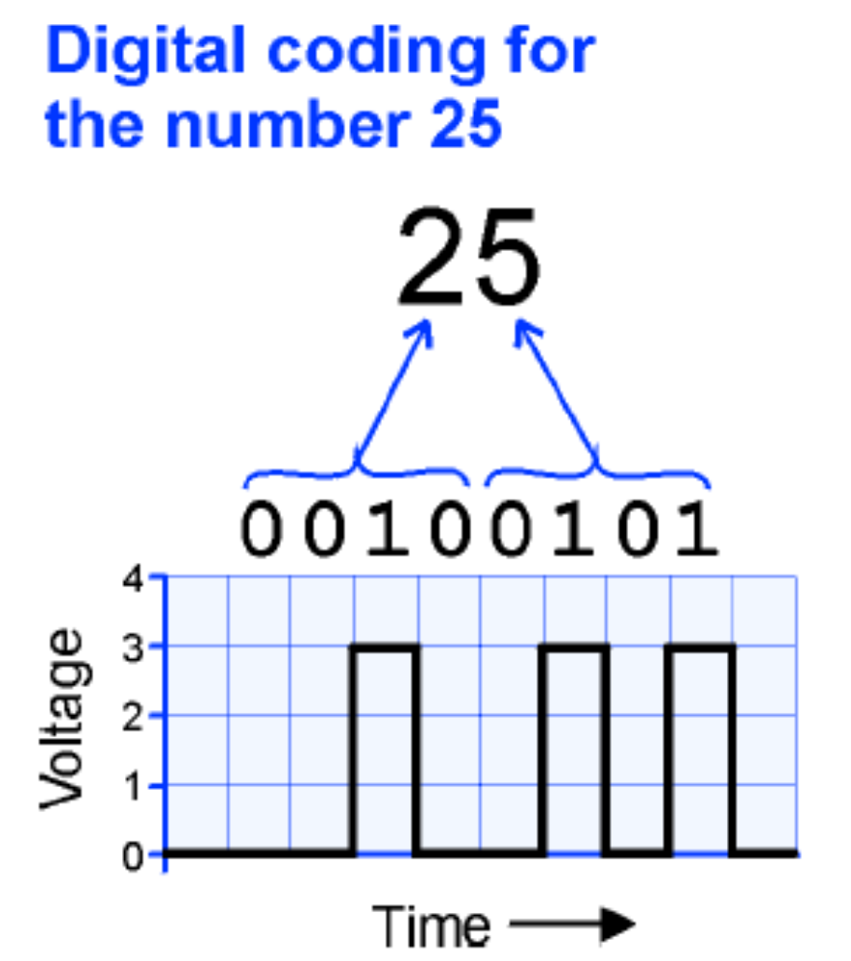

Slide 92
Thank you and Good Luck !!
F. K. Ampong FPGA & VHDL WORKSHOP KUMASI GHANA- 2005

